Slide 1
BGC Argo in Lofoten Basin for PROFHMM
https://fleetmonitoring.euro-argo.eu/dashboard
WMO# deployed last contacted
6900798 2010-07-02 2015-09-14 Temp, Chl-a, DOXY
6900799 2010-11-05 2013-09-20 Temp, Chl-a, PAR, DOXY
6901139 2012-08-28 2015-12-03 Temp, Chl-a, DOXY
6901140 2012-08-28 2016-03-16 Temp, Chl-a, DOXY
6901159 2014-01-22 2014-07-02 Temp, Chl-a, PAR, DOXY
6902549 2014-07-28 2018-02-07 Temp, Chl-a, DOXY
6902545 2014-01-22 2020-04-29 Temp, Chl-a DOXY
6902547 2014-01-22 2016-05-11 Temp, Chl-a, PAR, DOXY
6902550 2014-08-03 2017-12-09 Temp, Chl-a, DOXY
6903550 2019-05-20 2020-08023 Temp, Chl-a, PAR, DOXY
6903553 2019-05-20 2020-08-15 Temp, Chl-a, DOXY
6903568 2020-05-16 2020-08-26 Temp, Chl-a, DOXY

Slide 2
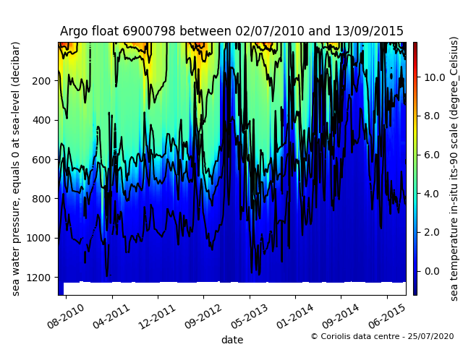
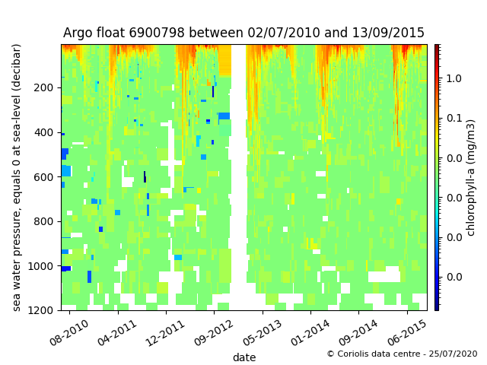
BGC Argo in Lofoten Basin for PROFHMM
WMO# deployed last contacted
6900798 2010-07-02 2015-09-14 Temp, Chl-a, PAR, DOXY

Slide 3
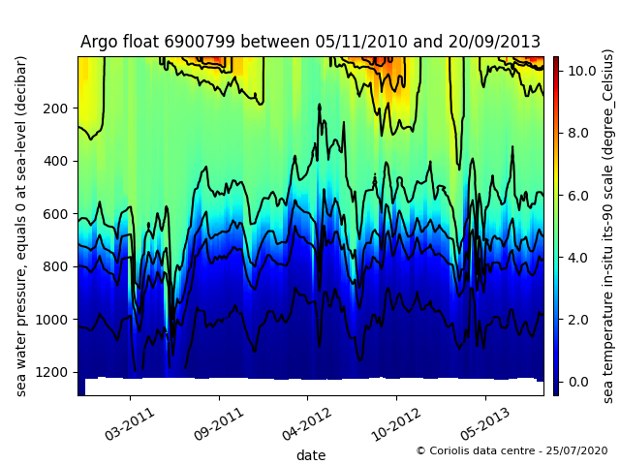
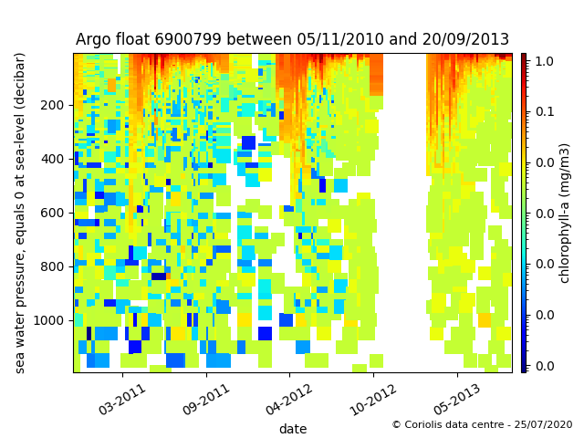
BGC Argo in Lofoten Basin for PROFHMM
WMO# deployed last contacted
6900799 2010-11-05 2013-09-20 Temp, Chl-a, PAR, DOXY

Slide 4
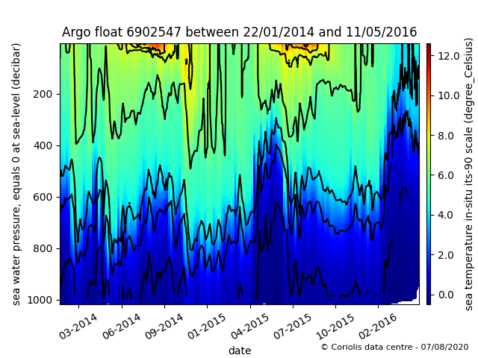
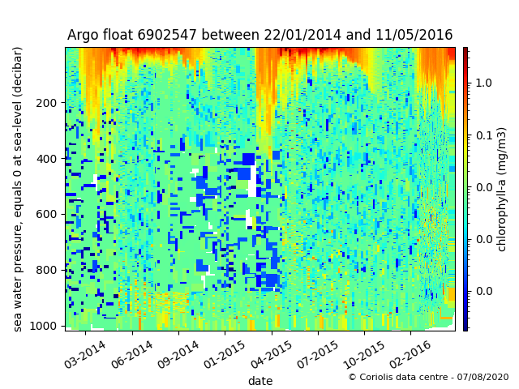
BGC Argo in Lofoten Basin for PROFHMM
WMO# deployed last contacted
6902547 2014-01-22 2016-05-11 Temp, Chl-a, PAR, DOXY

Slide 5
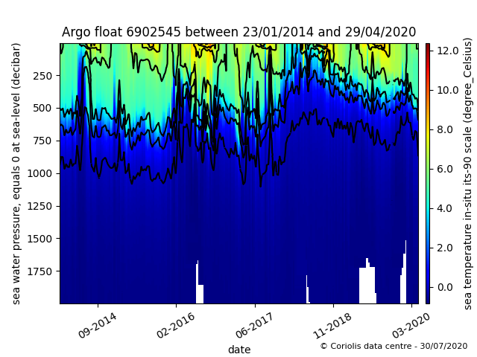
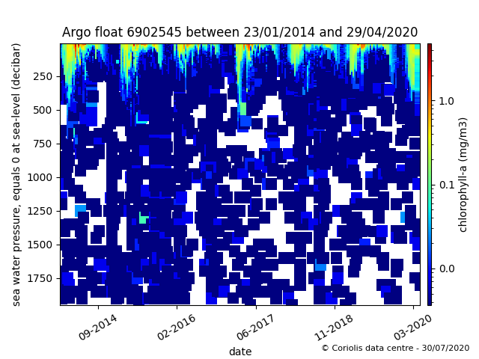
BGC Argo in Lofoten Basin for PROFHMM
WMO# deployed last contacted
6902545 2014-01-22 2020-04-29 Temp, Chl-a, PAR, DOXY

Slide 6
BGC Argo in Lofoten Basin for PROFHMM
List of tasks:
Download Argo data (for float with listed WMO number) in nerCDF format
a. from which portal? > CMEMS INS TAC
ftp://nrt.cmems-du.eu/Core/INSITU_GLO_NRT_OBSERVATIONS_013_030/glo_multiparameter_nrt/history/PF/
b. extract variables: Temperature, Chl-a, pressure, time > make sure to use bias corrected Chl-a (CPHL_ADJUSTED)
netCDF variable name: [TEMP, CPHL_ADJUSTED, PRES_ADJUSTED, TIME]
2. Interpolate vertical profile data (640 levels) to GOTM standard depth
a. conversion of pressure [dbar] to depth [m] > use 1.0 conversion ratio
b. plot profile data time series for visual inspection > 0-1000m depth range, use same color range as GOTM plot
3. Collocate float sampling positions with satellite SST, Chl-a and reanalysis downward short wave radiation data
a. which surface data? > needs discussion later (in September 2020?)
Chl-a: ESA OC-CCI daily?
SST: ? ESA SST-CCI daily?
DSWR: ERA Interim or ERA5 hourly data?
b. plot surface data time series for visual inspection
4. Test a set of data on PROFHMM

