Slide 1
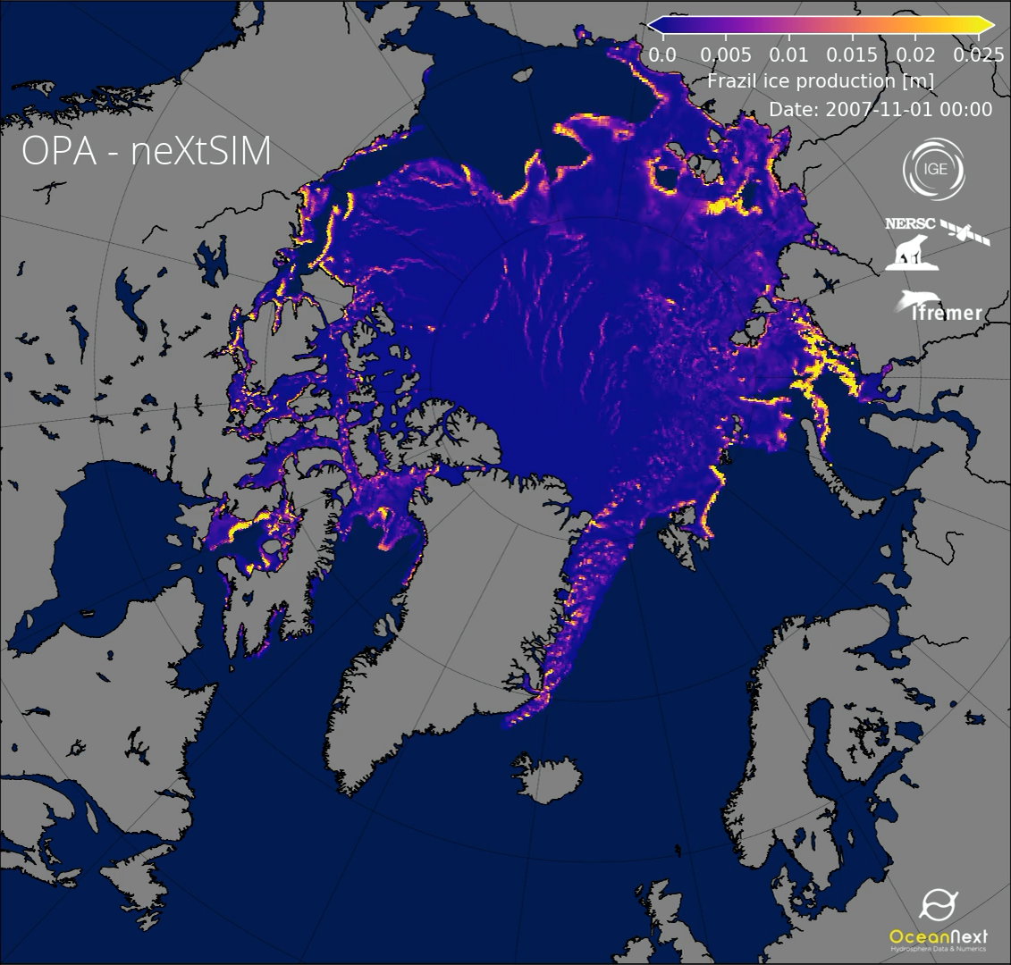
Ice formation in open water
(lateral growth)
November 2007 to March 2008

Slide 2
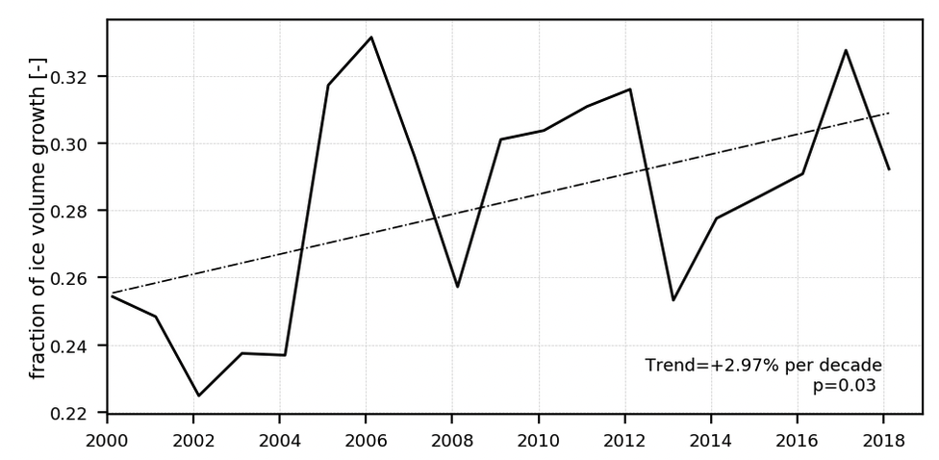
Arctic sea ice mass balance in a new coupled ice—ocean model using a brittle rheology framework
Scientific Achievement
Boutin, G., E. Ólason, P. Rampal, H. Regan, C. Lique, C. Talandier, L. Brodeau and R. Ricker
20 to 30% of winter ice production takes place in leads
There is a 3%/decade increasing trend in this production
This estimate is consistent with previous estimates
First long-term, pan-Arctic estimate of ice production in leads

