Slide 1
Regional ice flow implications
Led out of the Nansen Center, Bergen, Norway (Dr Einar Ólason & Dr Johnathan Rheinlander).
Using the next-generation sea-ice model, neXtSIM, developed in ouse
  Designed for medium to high resolution pan-Arctic sea-ice simulations
  Uses a unique rheology to describe the way the ice deforms and moves
  Captures the solid behaviour of sea ice, e.g. fracturing and landfast ice and ice arches.

Slide 2
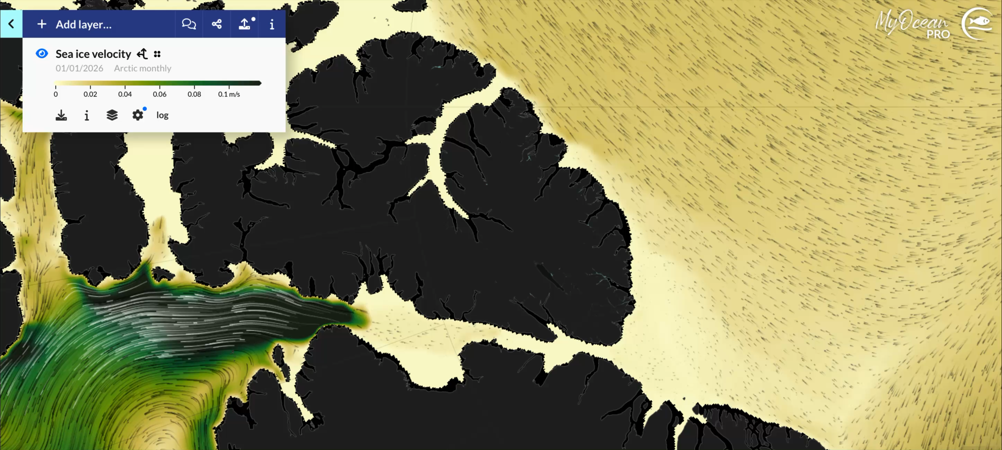
Regional ice flow implications
The flow of ice through Nares Strait may be blocked by a series of ice arches.
The arch strength depends on ice thickness.
NeXtSIM can reproduce the arches, so we will use it to
  Explore the thickness dependence of the arch strength
  The impact weaker arches have on Arctic ice export and circulation.
Mean ice drift from the Copernicus sea-ice forecast (using neXtSIM) for January, 2026. Note the blocking effect of the arch forming in Nares Strate.

Slide 3
Regional ice flow implications
The flow of ice through Nares Strait may be blocked by a series of ice arches.
The arch strength depends on ice thickness.
NeXtSIM can reproduce the arches, so we will use it to
  Explore the thickness dependence of the arch strength
  The impact weaker arches have on Arctic ice export and circulation.
Figure from Moor et al (2021) doi: 10.1038/s41467-020-20314-w

